Slide 1
MUSHROOM CULTURE TECHNOLOGY (I) Botany Hons – Sem : IV
Arup Ghosh
Dept. of Botany
Banwarilal Bhalotia College, Asansol

Slide 2
Definition
A mushroom, or toadstool, is the fleshy, spore-bearing fruiting body of a fungus, typically produced above ground on soil or on its food source.
The word "mushroom" is most often applied to those fungi (Basidiomycota, Agaricomycetes) that have a stem (stipe), a cap (pileus), and gills (lamellae, sing. lamella) on the underside of the cap.
"Mushroom" also describes a variety of other gilled fungi, with or without stems, therefore the term is used to describe the fleshy fruiting bodies of some Ascomycota. These gills produce microscopic spores that help the fungus spread across the ground or its occupant surface.

Slide 3
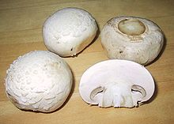
Few Pictures
The Agaricus bisporus, one of the most widely cultivated and popular mushrooms in the world

Slide 4
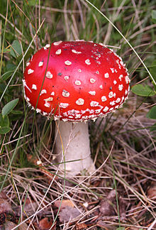
The toxic mushroom Amanita muscaria, commonly known as "fly agaric."

Slide 5
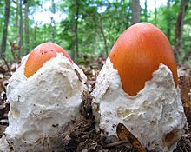
Amanita jacksonii buttons emerging from their universal veils".

Slide 6
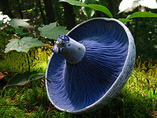
The blue gills of Lactarius indigo, a milk-cap mushroom

Slide 7
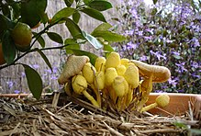
Yellow flower pot mushrooms (Leucocoprinus birnbaumii) at various states of development

Slide 8
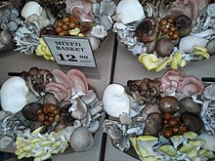
Culinary mushrooms are available in a wide diversity of shapes and colors at this market stand at the San Francisco Ferry Building

Slide 9
Nutrition
Mushrooms (brown, Italian)
or Crimini (raw)
Nutritional value per 100 g (3.5 oz)
Energy 94 kJ (22 kcal)
Carbohydrates
4.3 g
Fat
0.1 g
Protein
2.5 g
Vitamins Quantity %DV†
Thiamine (B1) 9% 0.1 mg
Riboflavin (B2) 42% 0.5 mg
Niacin (B3) 25% 3.8 mg
Pantothenic acid (B5) 30% 1.5 mg
Vitamin B6 8% 0.11 mg
Folate (B9) 6% 25 μg
Vitamin C 0% 0 mg
Vitamin D 1%

Slide 10
Minerals
Minerals Quantity %DV†
Calcium 2% 18 mg
Iron 3% 0.4 mg
Magnesium 3% 9 mg
Manganese 7% 0.142 mg
Phosphorus 17% 120 mg
Potassium 10% 448 mg
Sodium 0% 6 mg
Zinc 12% 1.1 mg
Other constituents Quantity
Selenium 26 ug
Copper 0.5 mg
Vitamin D (UV exposed) 1276 IU

Slide 11
Human use
Some mushrooms are used or studied as possible treatments for diseases, particularly their extracts, including polysaccharides, glycoproteins and proteoglycans.[39] In some countries, extracts of polysaccharide-K, schizophyllan, polysaccharide peptide, or lentinan are government-registered adjuvant cancer therapies,[40][41] even though clinical evidence of efficacy in humans has not been confirmed.[42]
Historically in traditional Chinese medicine, mushrooms are believed to have medicinal value,[43] although there is no evidence for such uses.
Other uses

Slide 12
Mushrooms are used extensively in cooking, in many cuisines (notably Chinese, Korean, European, and Japanese). Though neither meat nor vegetable, mushrooms are known as the "meat" of the vegetable world.[21]
Most mushrooms sold in supermarkets have been commercially grown on mushroom farms. The most popular of these, Agaricus bisporus, is considered safe for most people to eat because it is grown in controlled, sterilized environments. Several varieties of A. bisporus are grown commercially, including whites, crimini, and portobello. Other cultivated species available at many grocers include Hericium erinaceus, shiitake, maitake (hen-of-the-woods), Pleurotus, and enoki. In recent years, increasing affluence in developing countries has led to a considerable growth in interest in mushroom cultivation, which is now seen as a potentially important economic activity for small farmers.[22]

Slide 13
Mushrooms can be used for dyeing wool and other natural fibers. The chromophores of mushroom dyes are organic compounds and produce strong and vivid colors, and all colors of the spectrum can be achieved with mushroom dyes. Before the invention of synthetic dyes, mushrooms were the source of many textile dyes.[44]
Some fungi, types of polypores loosely called mushrooms, have been used as fire starters (known as tinder fungi).
Mushrooms and other fungi play a role in the development of new biological remediation techniques (e.g., using mycorrhizae to spur plant growth) and filtration technologies (e.g. using fungi to lower bacterial levels in contaminated water).[45]

Slide 14
Facts and Myths About Poisonous Mushrooms
Learning about poisonous mushrooms is crucial if you want to start eating specimens you find in the woods. The consequences of eating the wrong wild mushroom range from dizziness to severe diarrhea to even death. Yes, you can die from making a mistake.
Always make a positive identification and only eat young, fresh specimens. For your own safety, there must be no doubt in your mind. If eating something new for the first time, only try a small amount and wait 24 hours to see if it effects you negatively.

Slide 15
A Few Poisonous Species
Poisonous species in the Lepiota genus such as Lepiota josserandii, Lepiota castanea, and Lepiota helveola. They have the same amatoxins as certain species of Amanita and can be deadly.
Chlorophyllum molybdites is sometimes known as the "green spored Lepiota" due to its spore print. These can cause extreme sickness.
Certain species of boletes are known to be poisonous such as Boletus satanas.
The Clitocybe and Inocybe genera contain a number of poisonous species. These can be difficult to identify and I think it's best to avoid these genera altogether.
The Cortinarius genus also contains many dangerous species. Some have a very beautiful purple color!And many more! With so many poisonous mushroom species out there, you can see why it's important to educate yourself and be cautious.

Slide 16
Thanks

